Slide 1
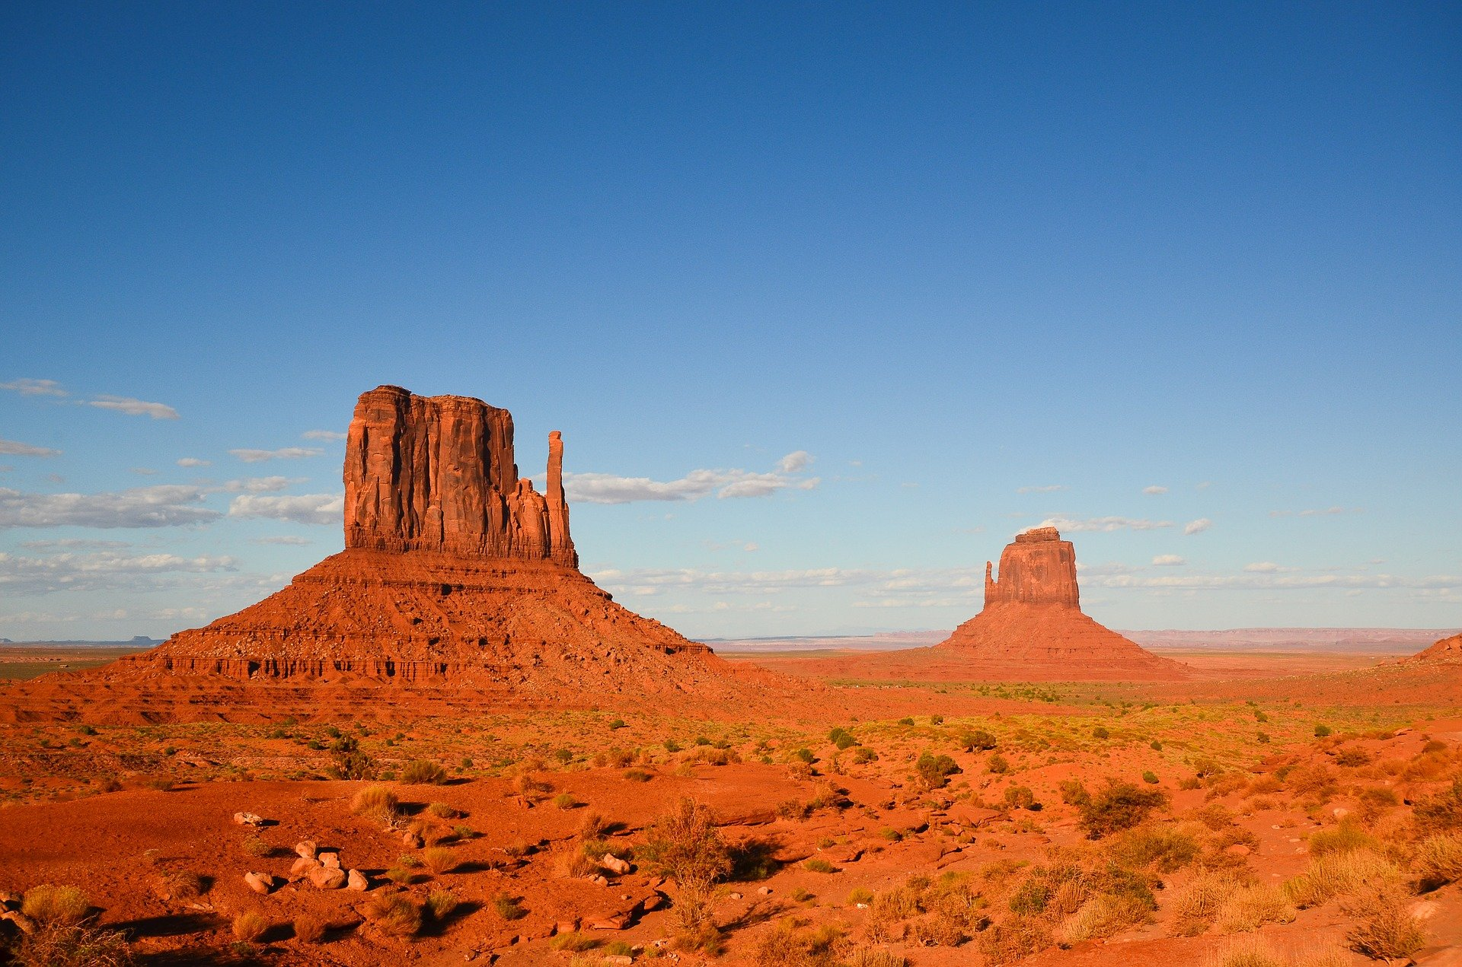
Geologic History of Utah

Slide 2
Why do we care about the past?

Slide 3
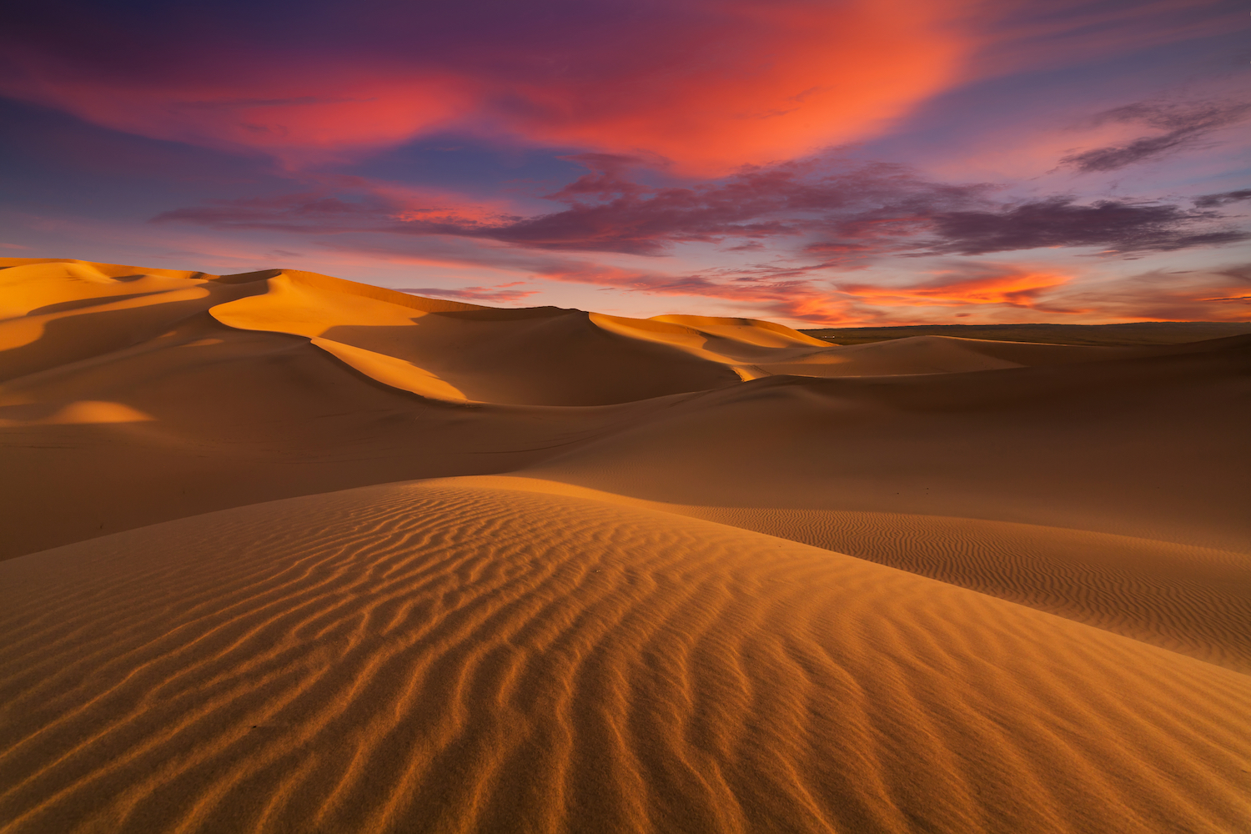
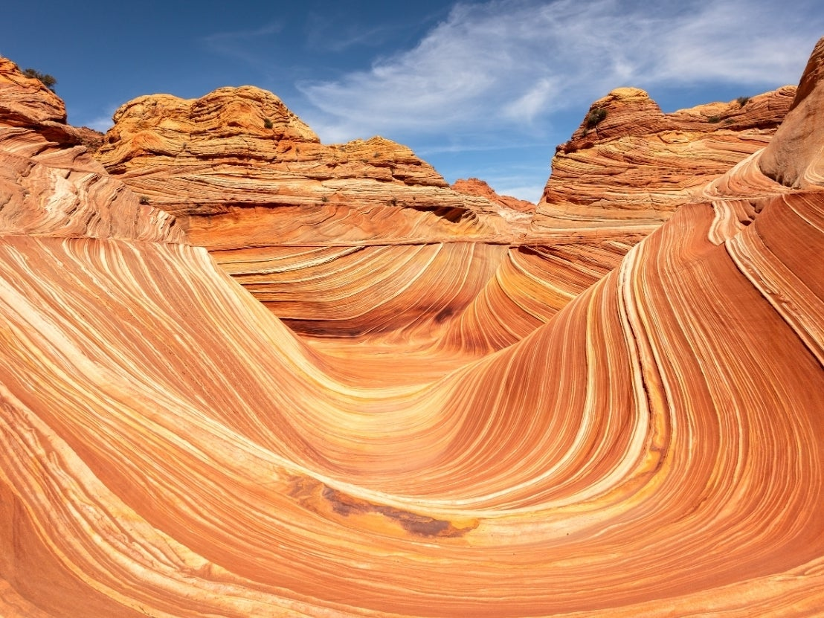
Why do sedimentary rocks matter?
Sedimentary rocks form from eroded fragments of other rocks collected in low lying areas
They are the record of Earth’s surface and past environments
With sedimentary rocks, we can essentially travel back in time to figure out how Earth has changed through its history

Slide 4
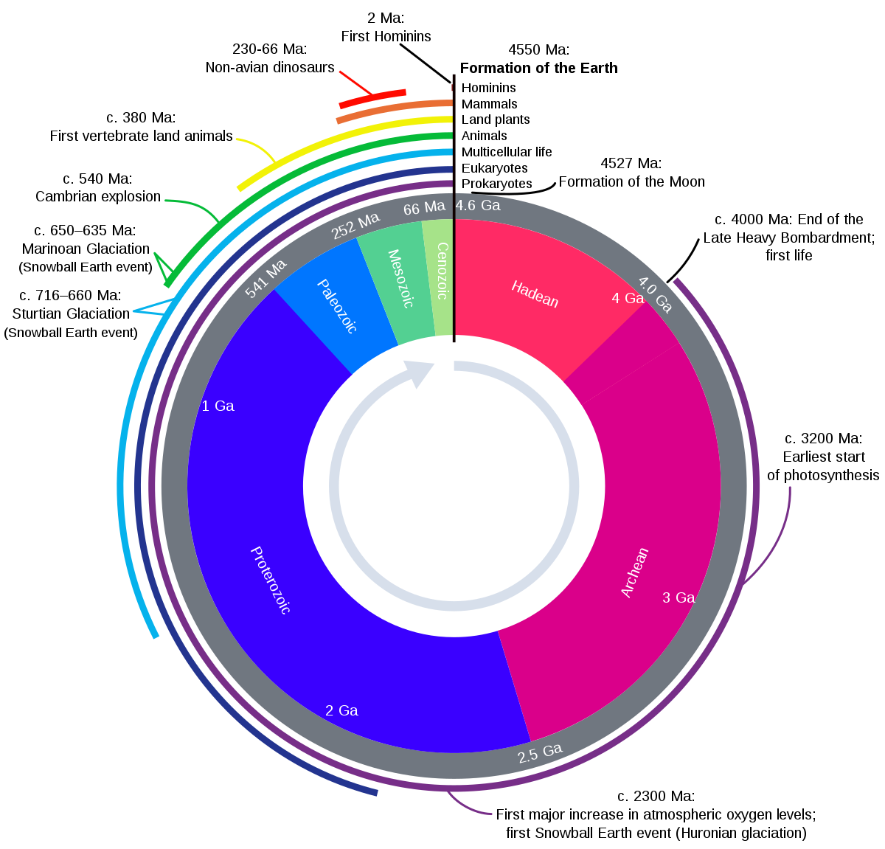
Geologic Time
Earth formed 4.5 billion years ago
But, complex life only really started about 540 million years ago, in the Cambrian

Slide 5
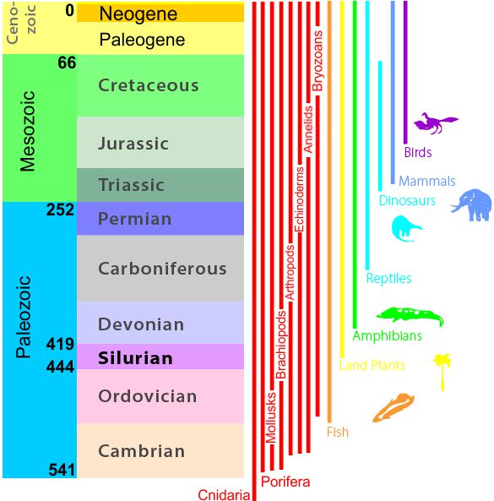
Geologic Time
Earth formed 4.5 billion years ago
But, complex life only really started about 540 million years ago, in the Cambrian
The Colorado Plateau has been continuously recording Utah’s environments since the Cambrian, 500 million years ago!

Slide 6
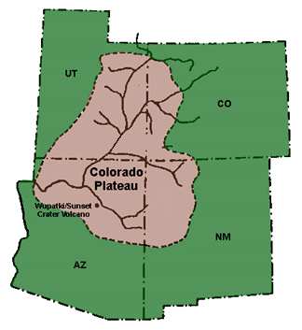
Colorado Plateau
The Colorado Plateau has been relatively stable for the past 500 million years, and has recorded the past environments through that time
It also has many national parks – can you think of any?

Slide 7
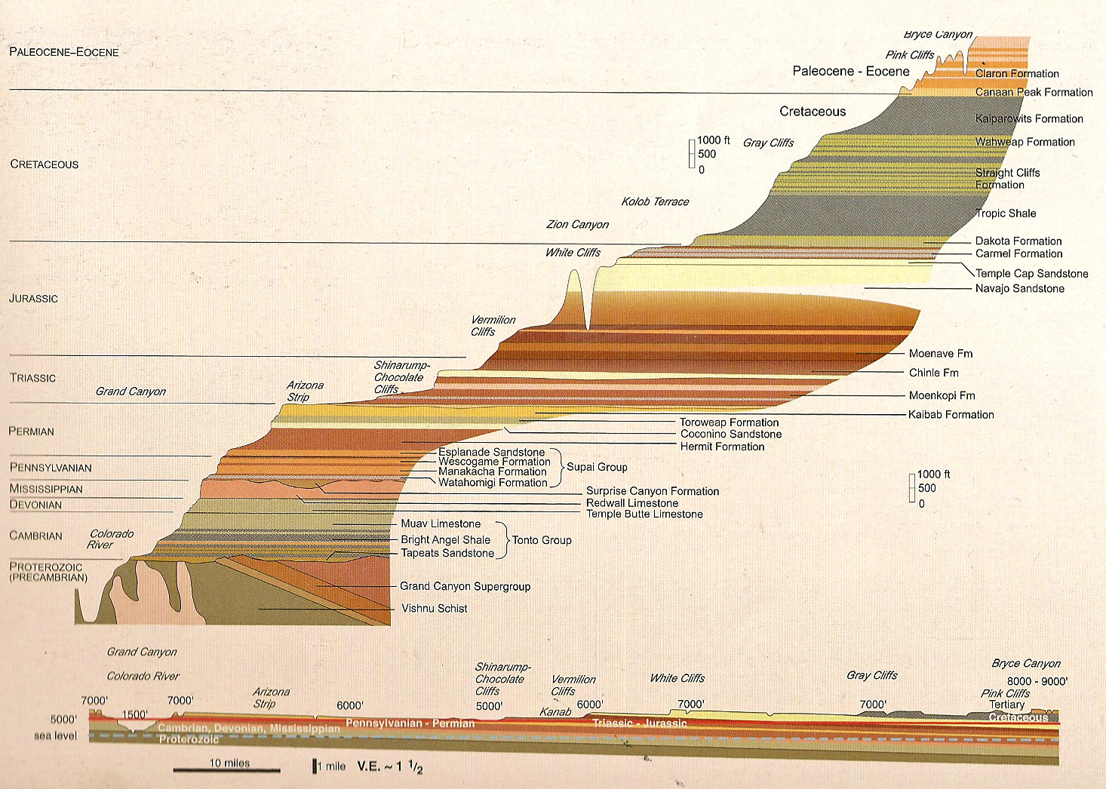
Colorado Plateau
It’s essentially a preserved stack of pancakes that has been cut through by rivers so we can see the rocks
Rare to find such a complete record
We’ll be using it for our case study

Slide 8
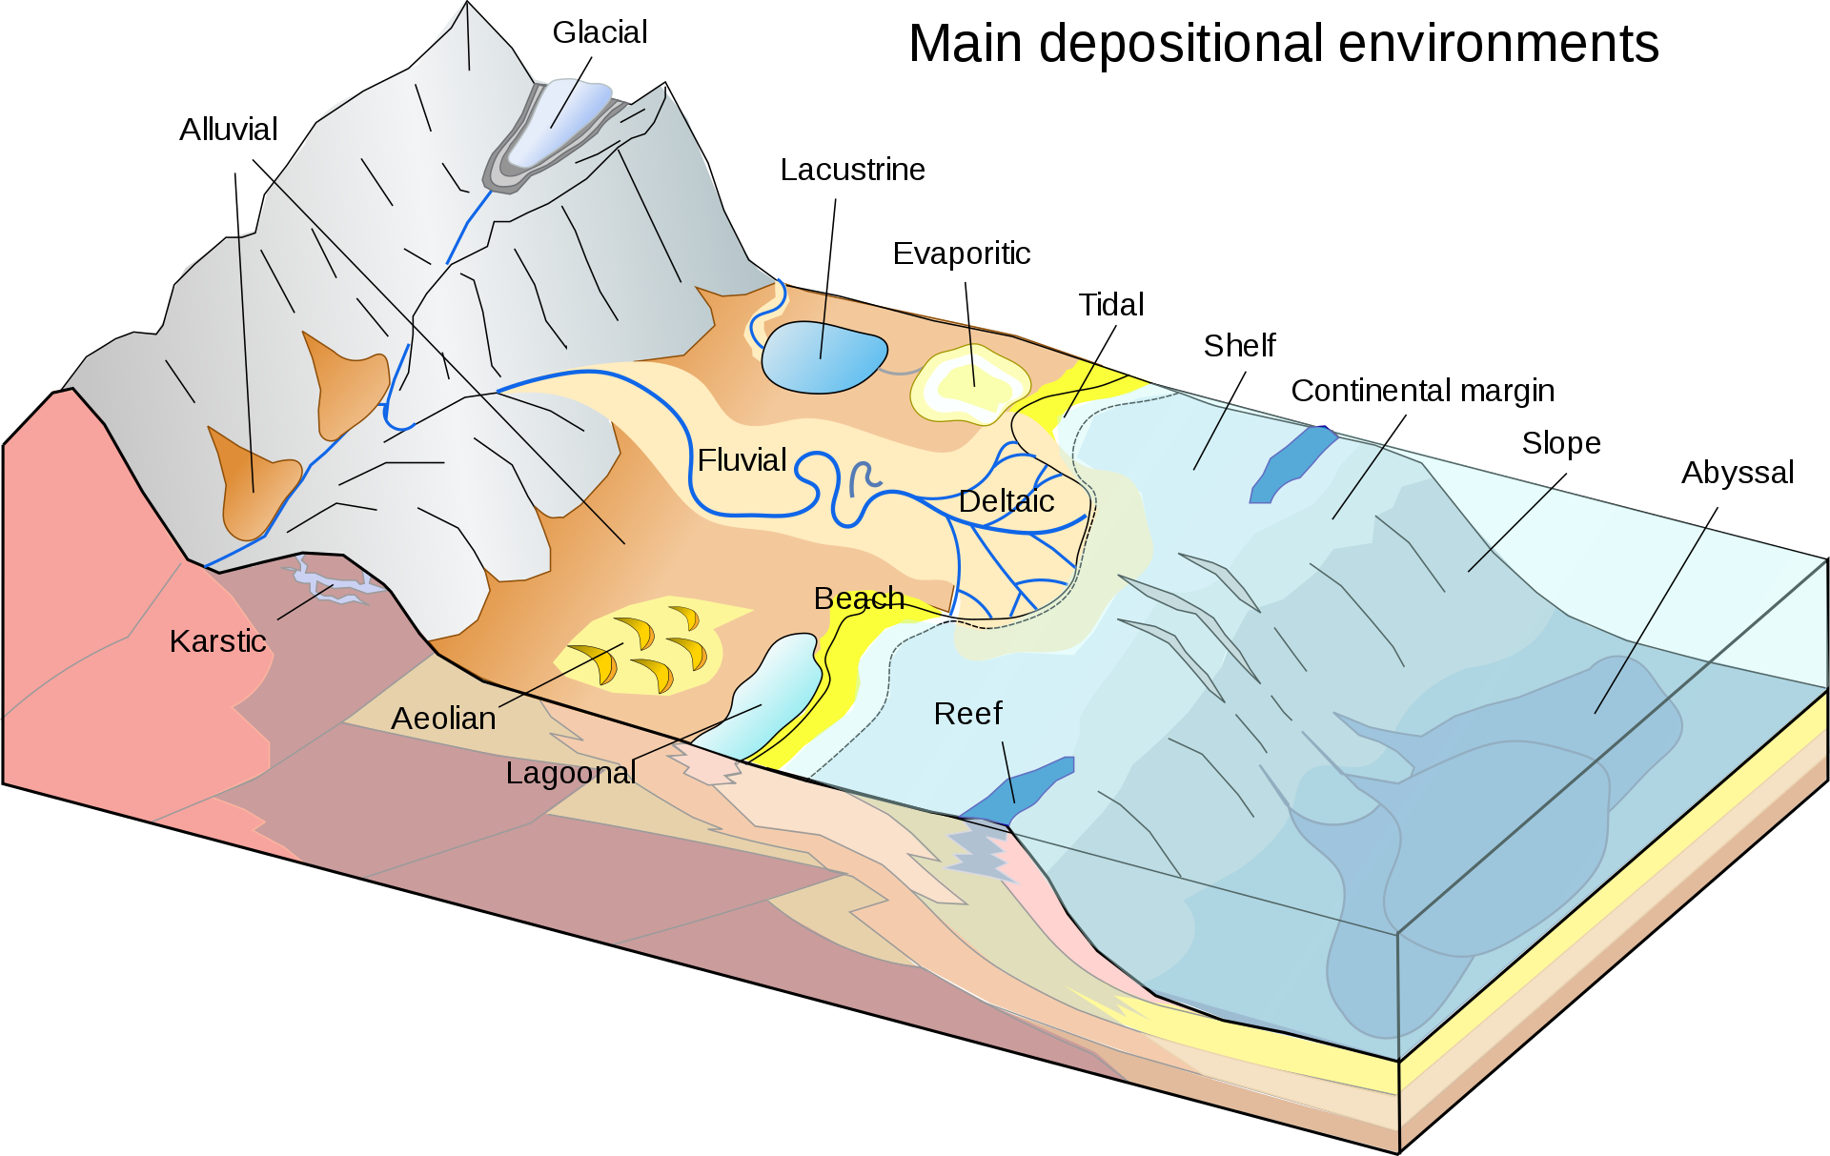
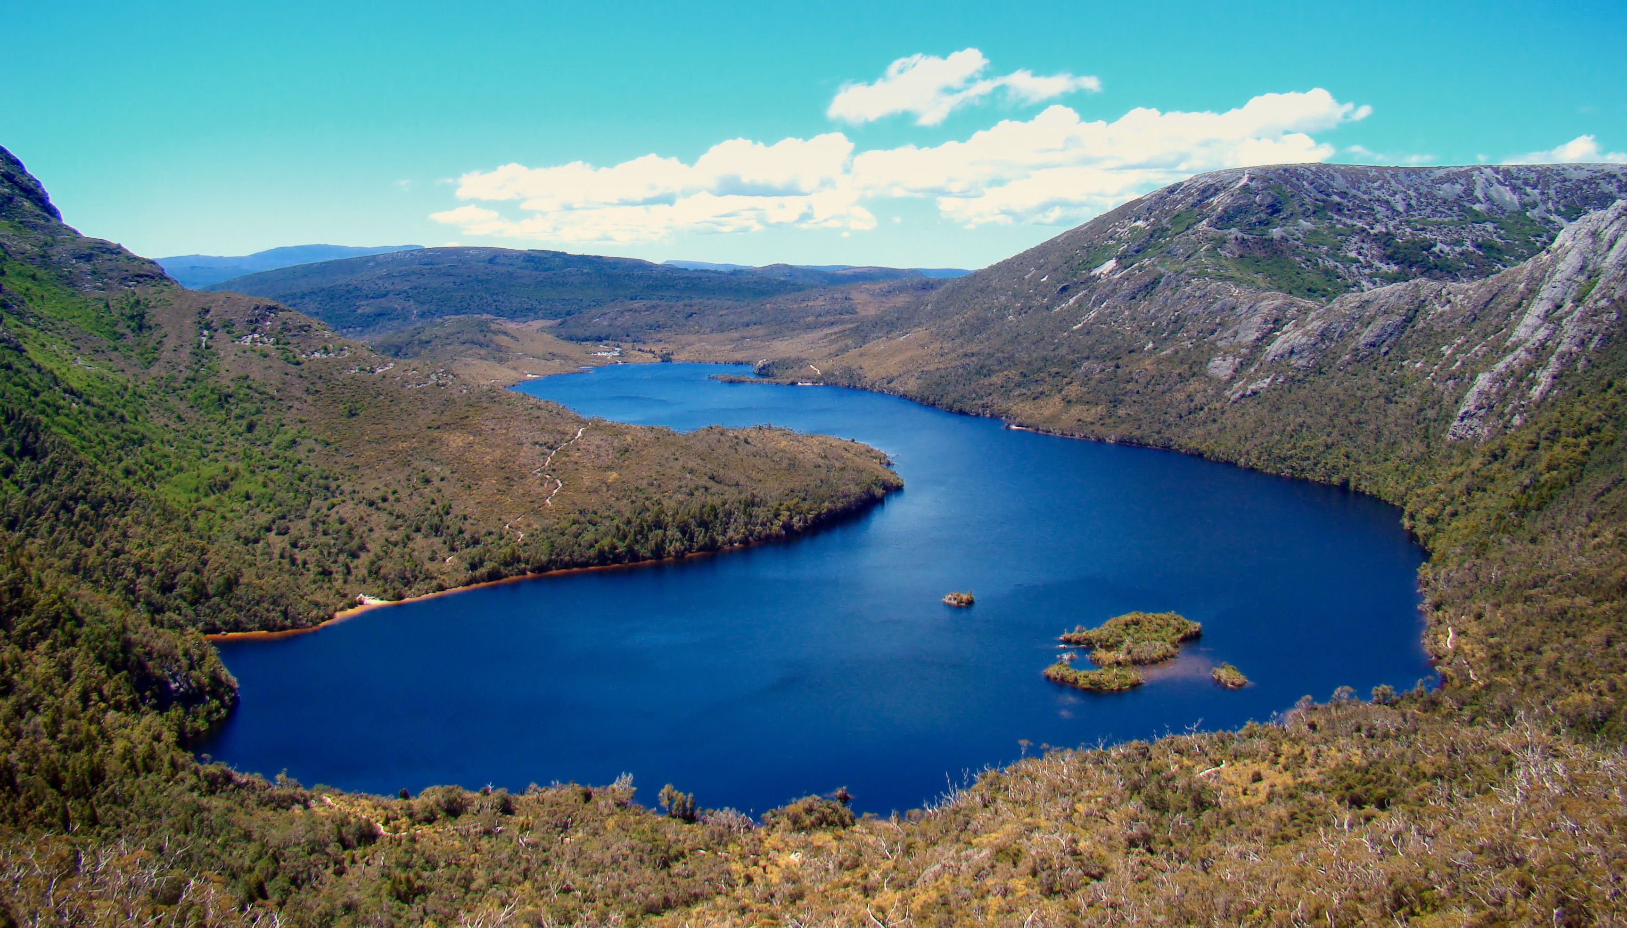
Depositional Environment: Continental - Lake
Low-medium energy
Creates silty rocks, with some limestone

Slide 9
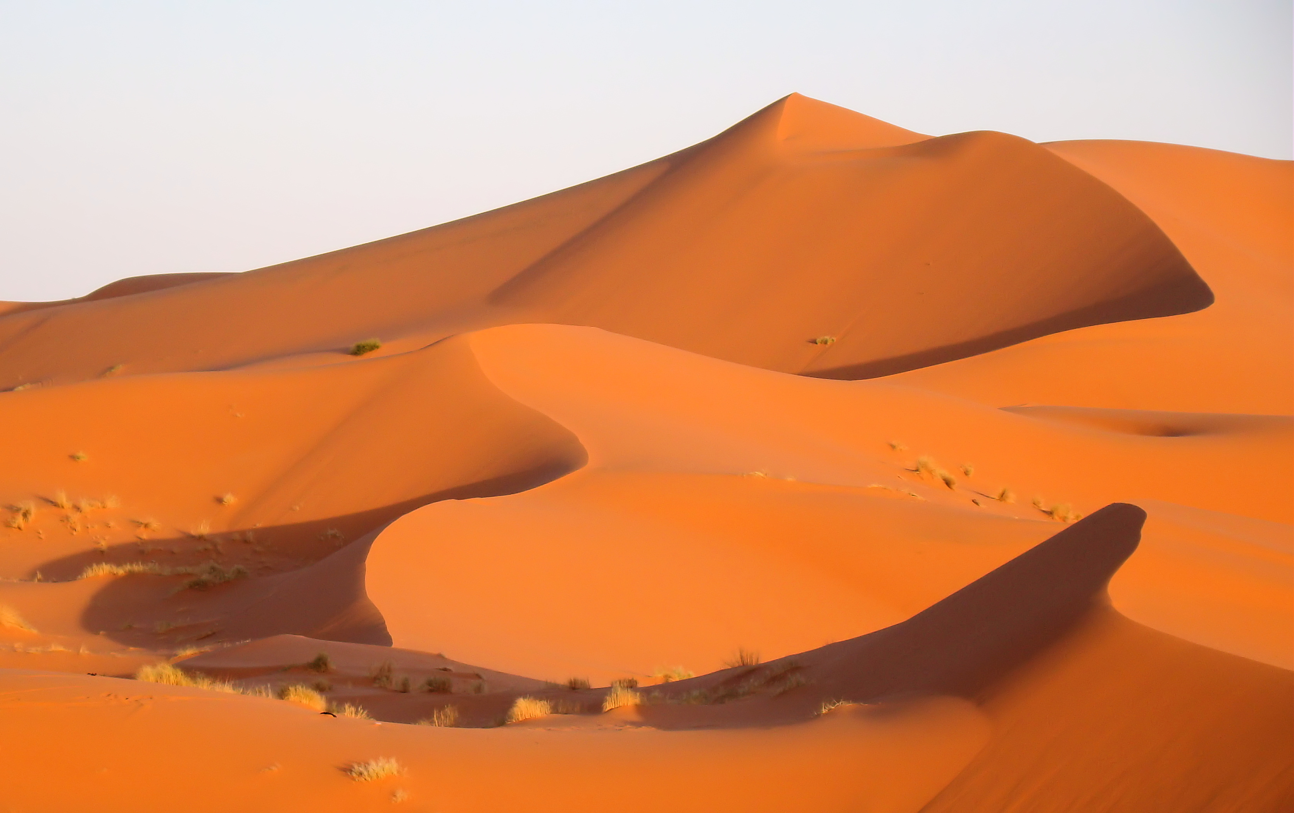
Depositional Environment: Continental - Desert
Medium energy
Creates sandstones with large crossbeds

Slide 10
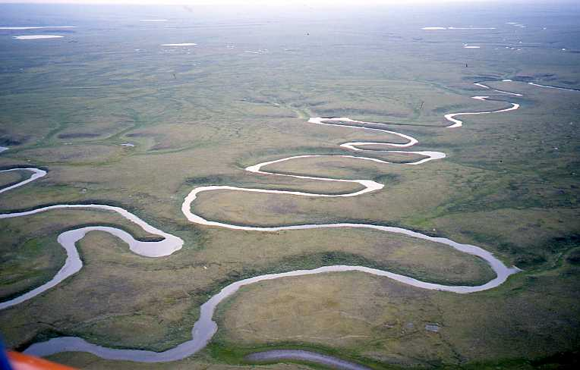
Depositional Environment: Continental - River
Low energy (floodplain) or medium energy (channel)
Creates colorful shales with plant roots, or sandstones from the main channel

Slide 11
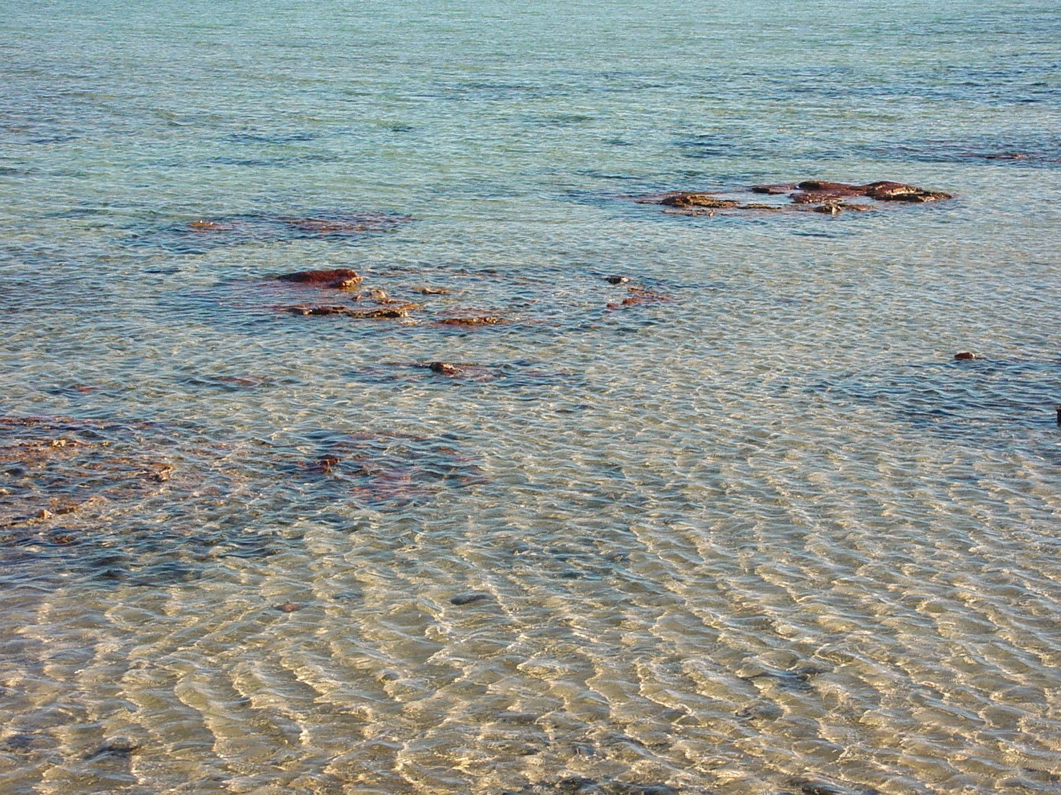
Depositional Environment: Marine - Shallow
Low energy, with a lot of light for corals etc. to make calcium carbonate bodies
Creates limestones with marine fossils

Slide 12
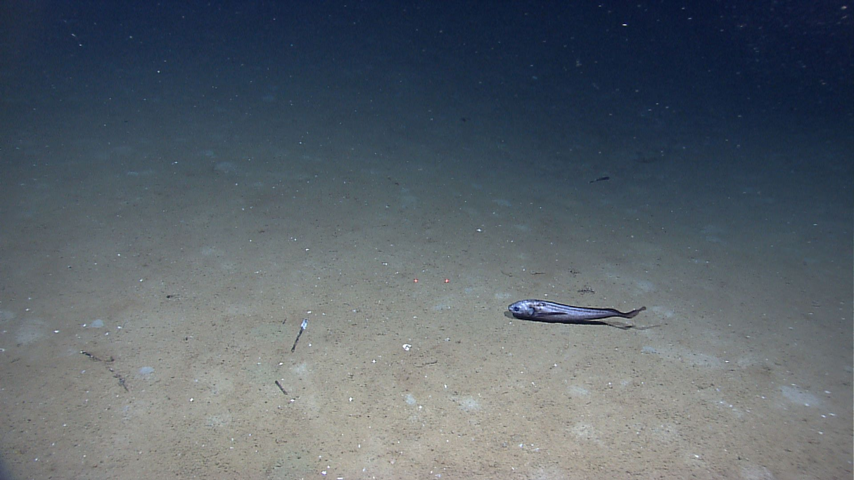
Depositional Environment: Marine – Deep
Low energy
Creates shales from mud grains that drop out of suspension

Slide 13
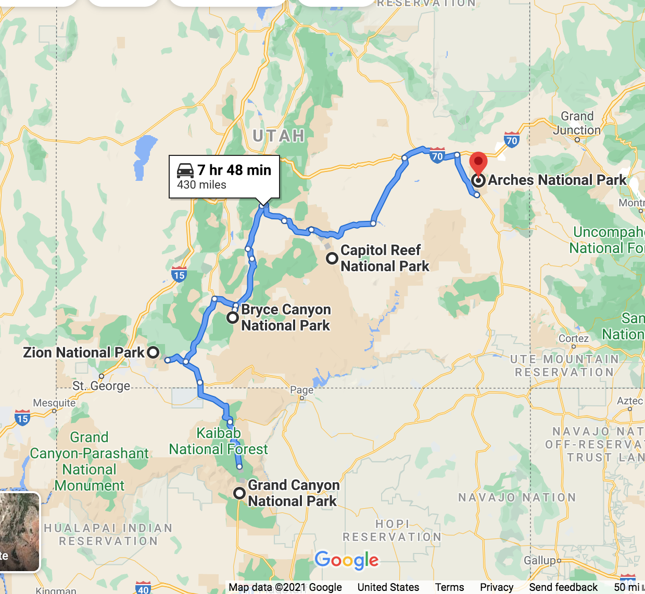
Activity: Road Trip!
To understand the geologic history of the Colorado Plateau and Utah, we’re going on a (virtual) roadtrip!
At each of the “stops,” study the stratigraphic column, provided pictures, and 3D models. Use these to answer questions about the depositional environment and geologic history of each stop.

Slide 14
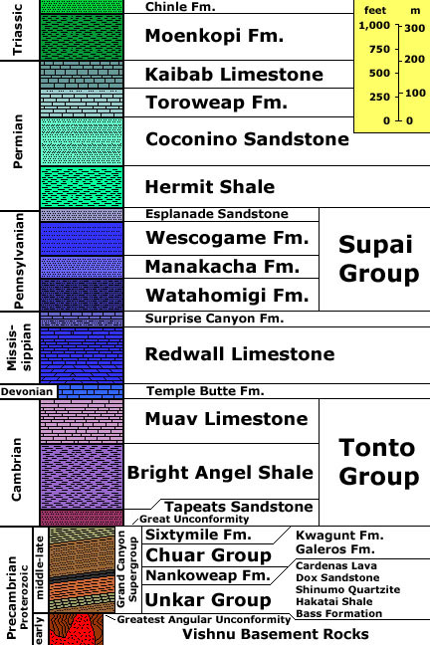
Stop 1. Grand Canyon National Park
The Grand Canyon exposes billions of years of history, thanks to the Colorado River eroding through the rock. We’re going to focus on Cambrian and younger rocks.

Slide 15
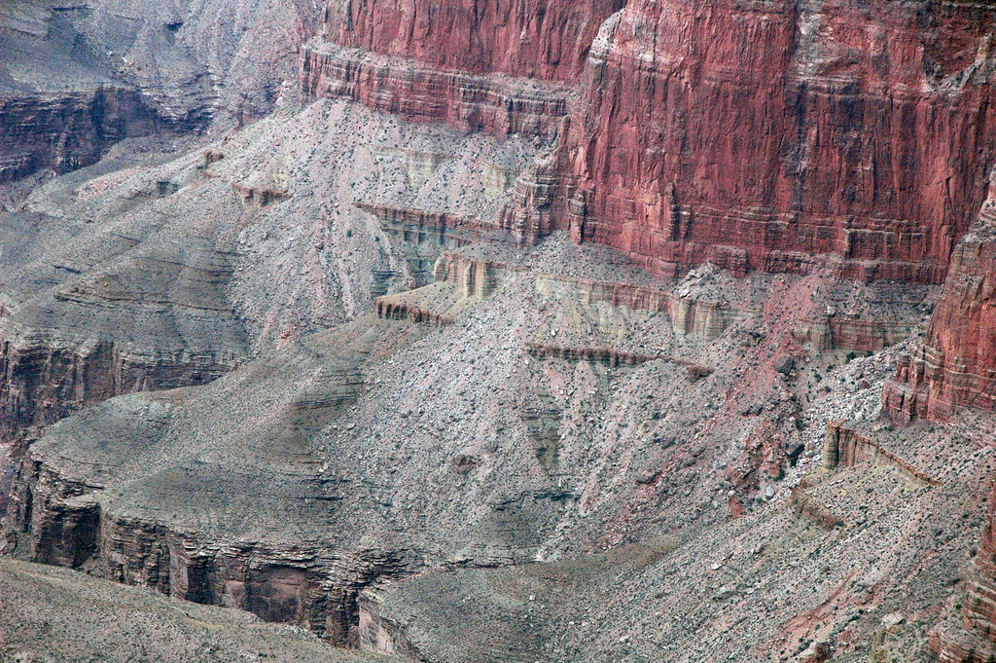
Tonto Group
The Tonto Group consists of 3 formations:
  Muav Limestone
  Bright Angel Shale
  Tapeats Sandstone
Did the Tonto Group form in a marine or continental environment?

Slide 16
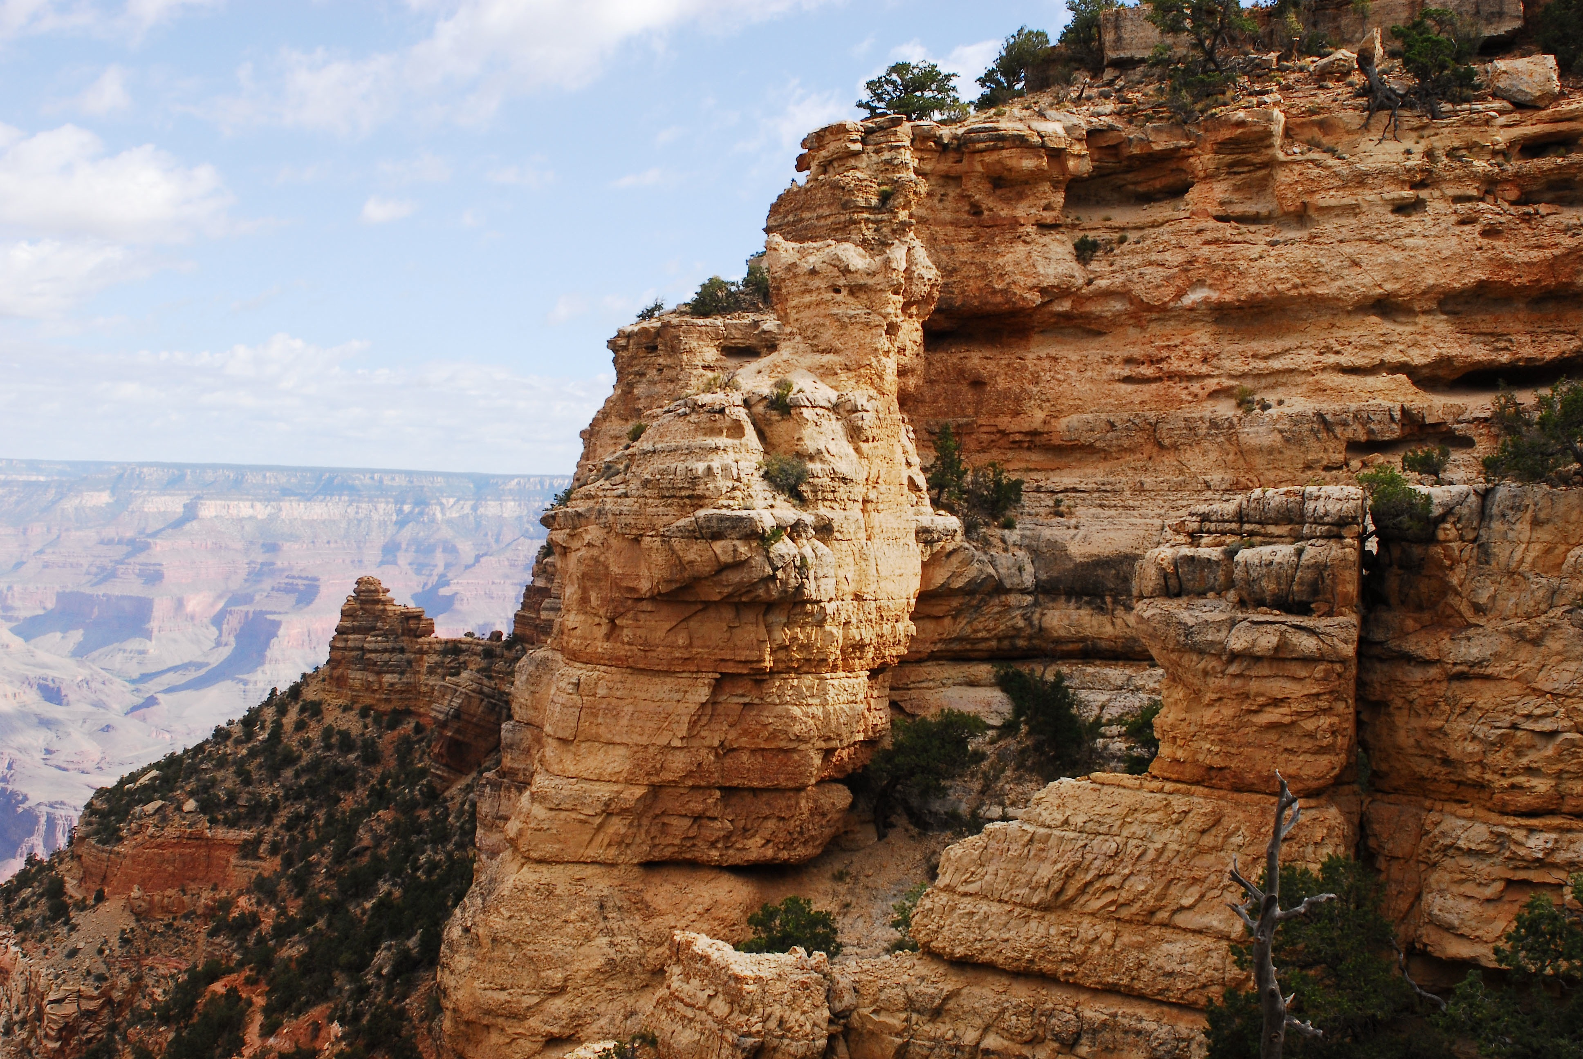
Kaibab Formation
The Kaibab Formation is a limestone at the top of the Grand Canyon sequence
This is an example of a rock that you would find in this formation
What kind of fossils do you see in the 3D rock model? In what depositional environment did the Kaibab Formation form?

Slide 17
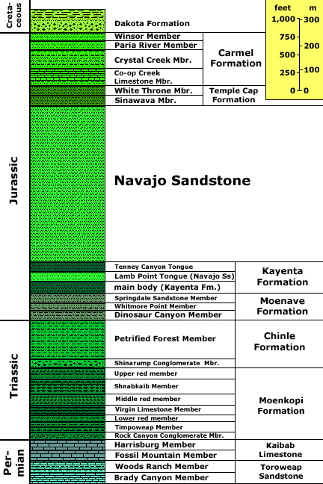
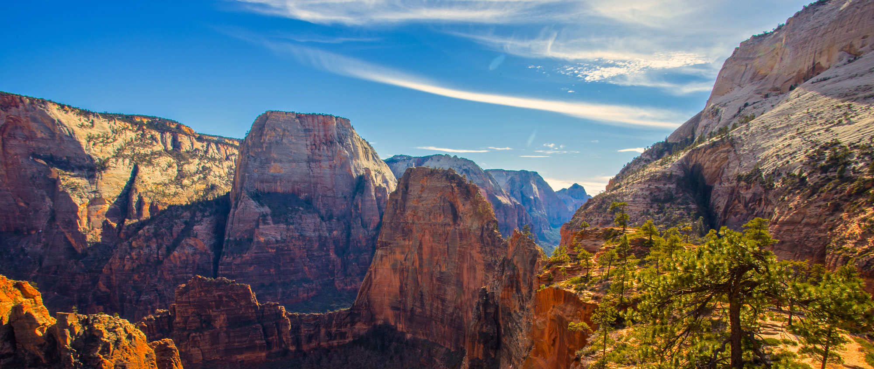
Stop 2. Zion National Park
Zion National Park is next on the “trip.” This canyon was carved out by the Virgin River, and the steep canyon walls are primarily composed of Navajo Sandstone.

Slide 18
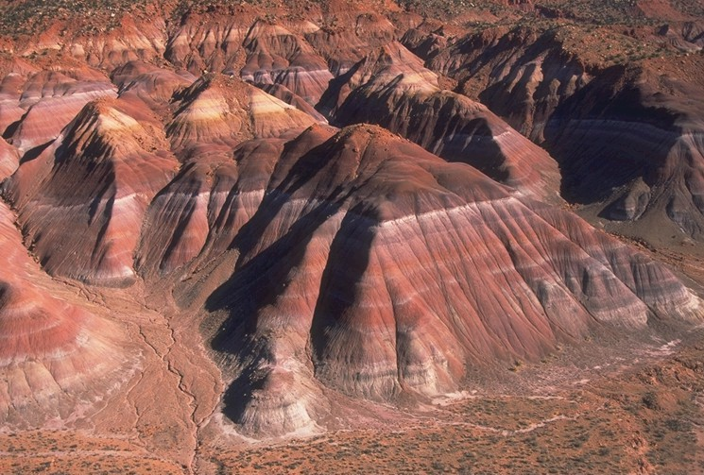
Chinle Formation
The Chinle Formation is composed of multiple colored shales that erode into soft hills
Here is a fossil that can be found in the Chinle Formation
Based on the grain size and the example fossil, in what kind of environment did the Chinle Formation form?

Slide 19
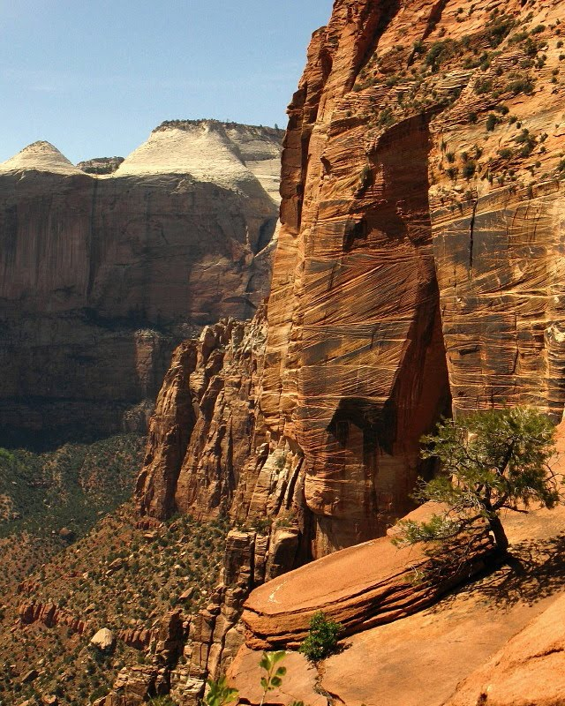
Navajo Sandstone
The Navajo Sandstone is a thick rock unit that has large cross-beds and forms cliffs
3D model of a sample from a rock like this formation
What kind of rock is the 3D model? What sedimentary features do you see?
In what kind of environment did the Navajo Sandstone form?

Slide 20
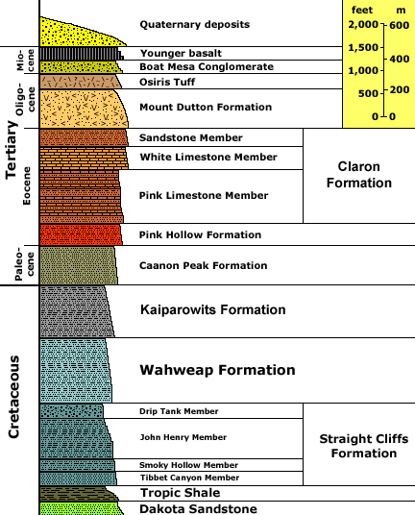
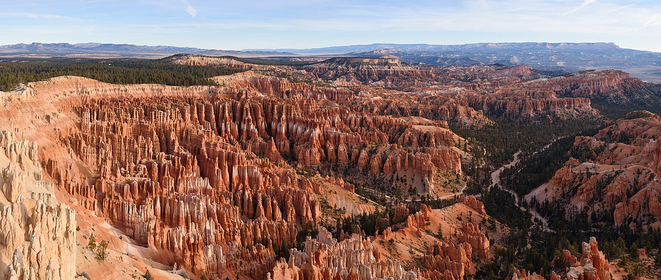
Stop 3. Bryce Canyon National Park
Bryce Canyon has these neat features called “hoodoos” that result from the weathering of the rock. This park includes the youngest rocks of the Colorado Plateau.

Slide 21
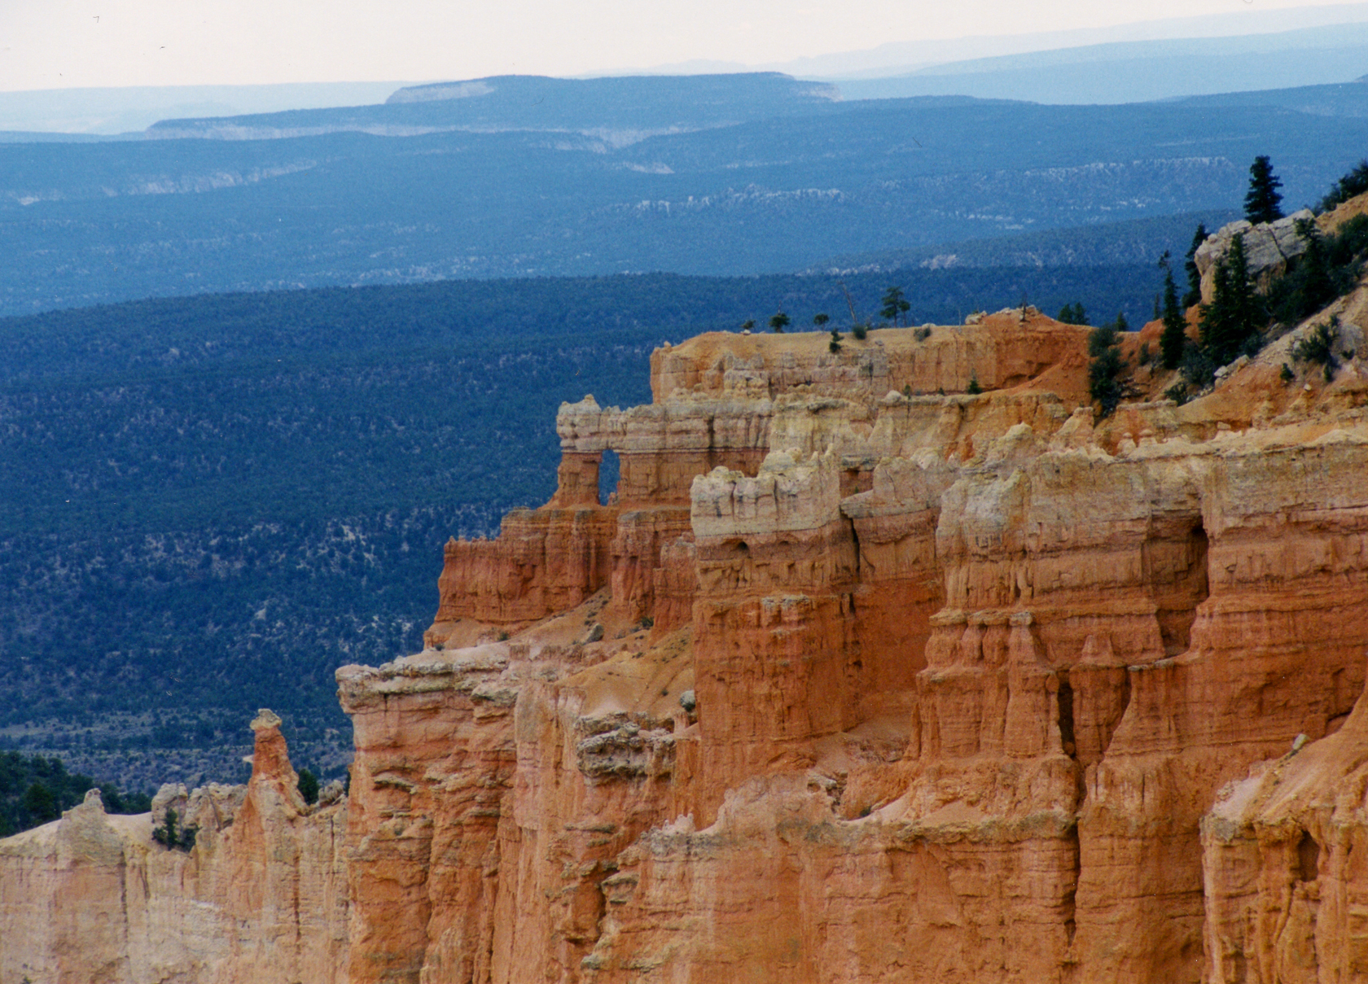
Claron Formation
The Claron Formation is composed of siltstone and limestone material, which weathers into these rock features, called hoodoos
In what energy environment did the Claron Formation form?

Slide 22
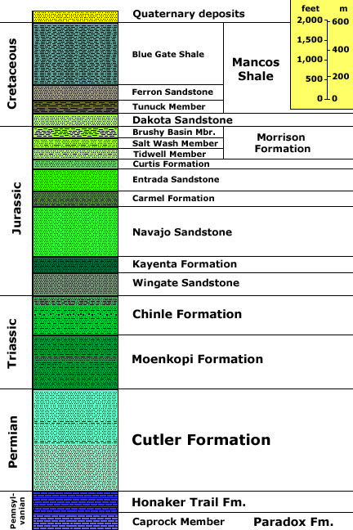
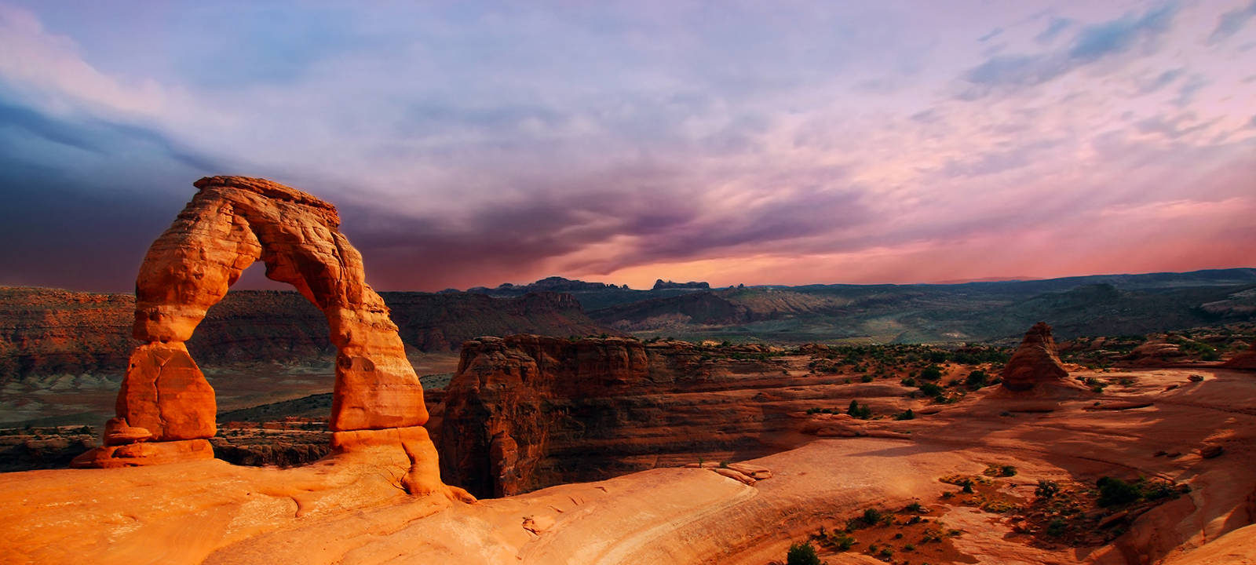
Stop 4. Arches National Park
Arches National Park, near Moab, has fantastic sandstone features! Delicate Arch (also on Utah’s license plate), is composed of the Entrada Sandstone, which formed in a massive desert of sand dunes

Slide 23
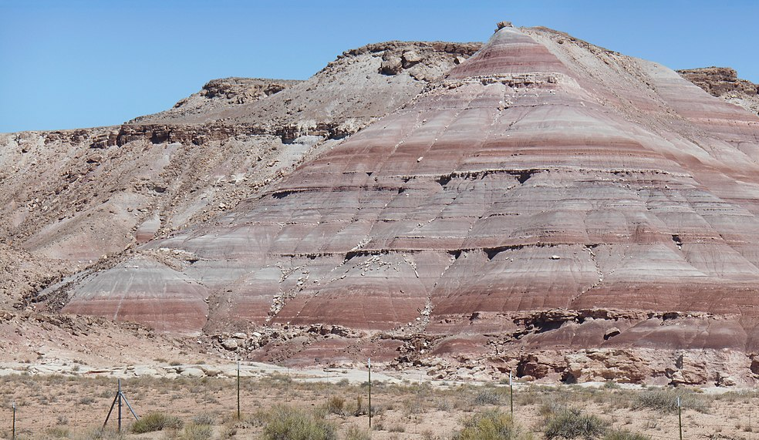
Morrison Formation
The Morrison Formation is composed of colorful shales and sandstones that alternate
Here is a fossil found in the Morrison Formation
In what kind of depositional environment did the Morrison Formation form?

Slide 24
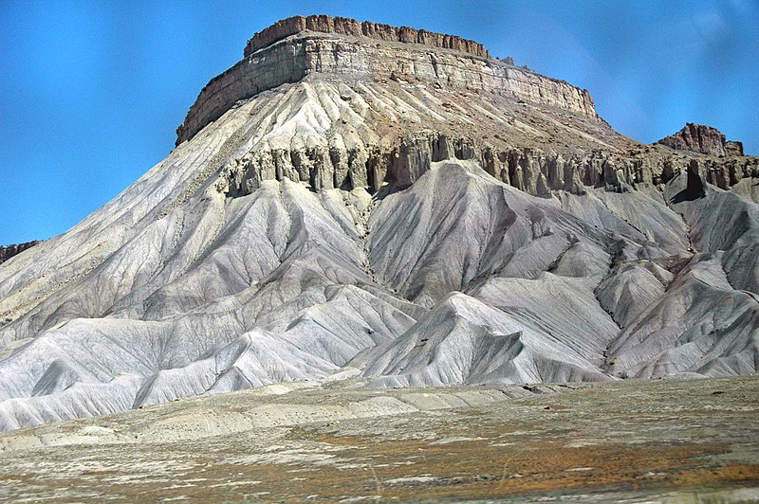
Mancos Shale
The Mancos Shale is a gray rock that weathers into soft hills.
Here is a fossil that was found in the Mancos Shale
What kind of fossil is found in the Mancos Shale? What does that tell you about the depositional environment?
What is the depositional environment of the Mancos Shale?

Slide 25
Next:
Fill out the charts on your handout and use them to answer the final questions:
Based on this chart, what is the geologic history of Utah, from the Cambrian to the Eocene?
What do you think could prompt environmental changes like these?
What changes do you think we might see recorded in the rocks in the future?

